Slide 1
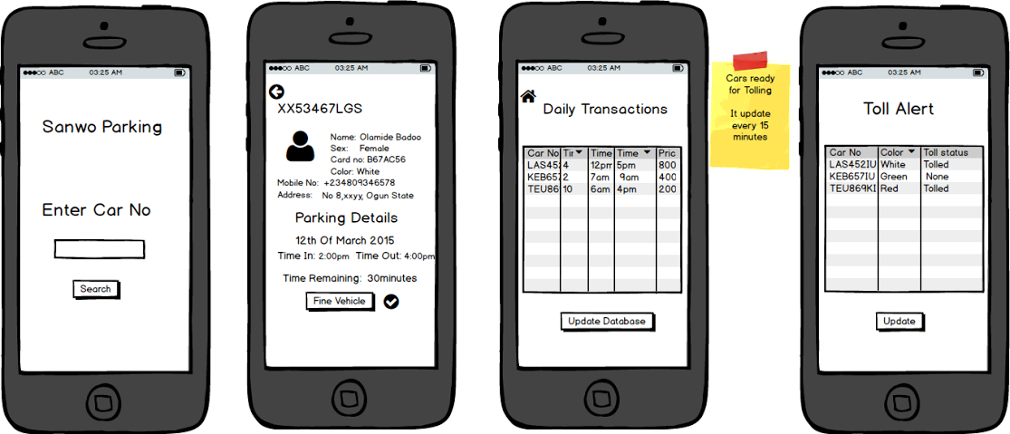
How it works : Enforcement

